Slide 1

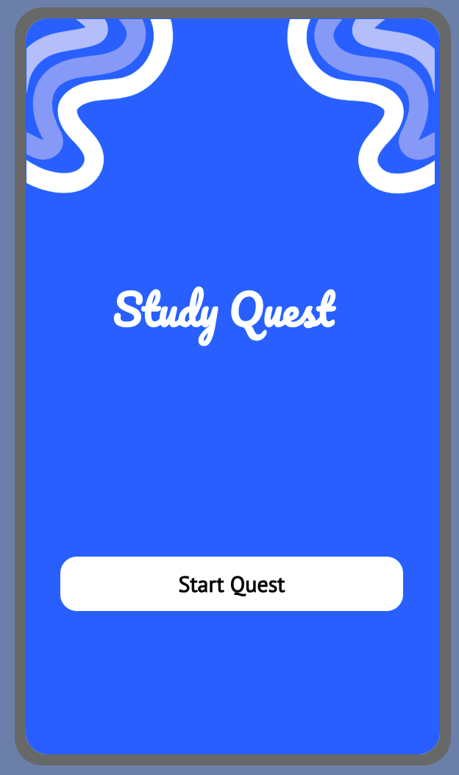
Study Quest
A productivity app helping students stay focused, built by Isabella Aleksander

Slide 2



  Students struggle to focus while studying
  Many cant study for more than 14 minutes before checking their phone
  40% blame social media distractions
  Eve having a phone nearby reduces focus on schoolwork.
The Problem
1

Slide 3


Why Current Solutions wont Work
  Feel boring or overwhelming
  Rely only on reminders
  Don’t motivate students
  Ignore digital distraction

Slide 4
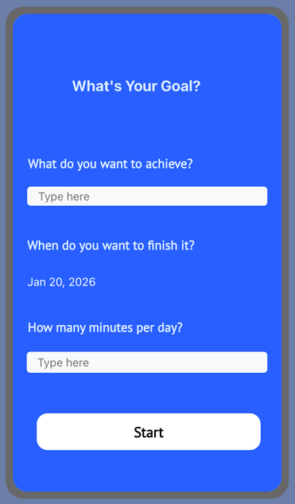
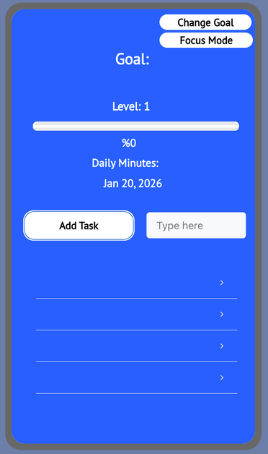
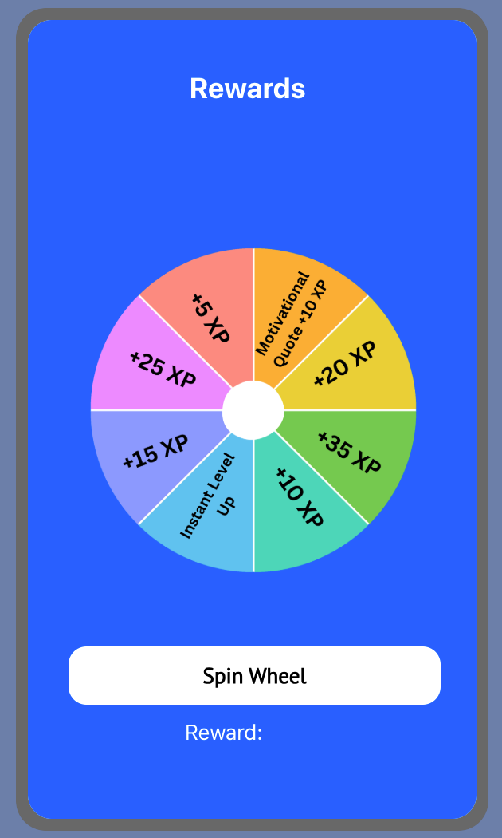

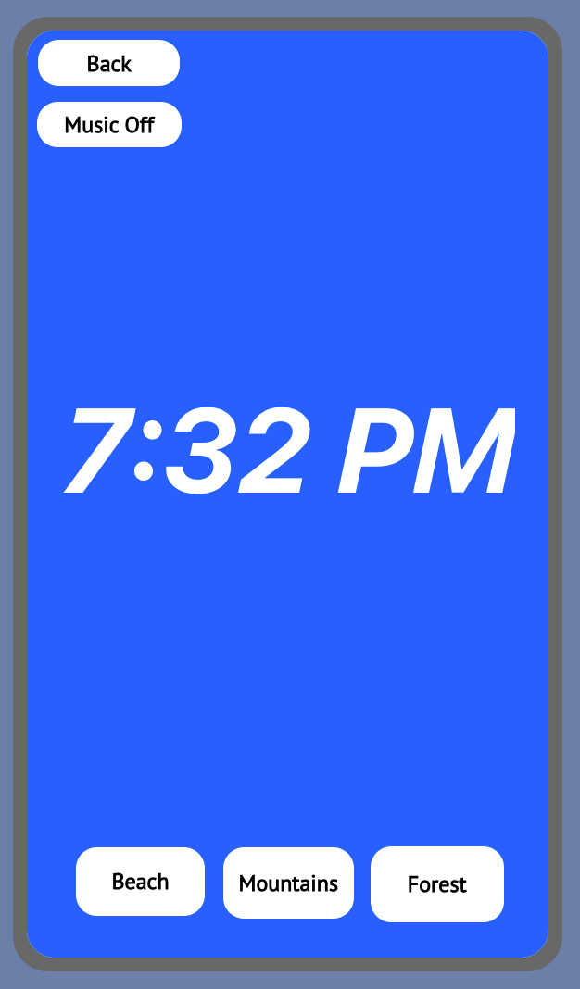
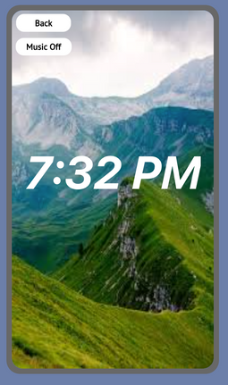
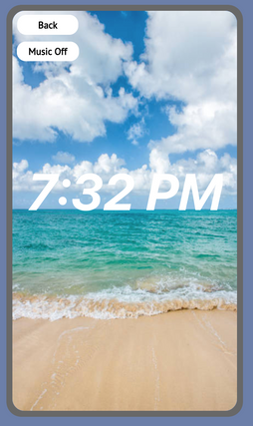
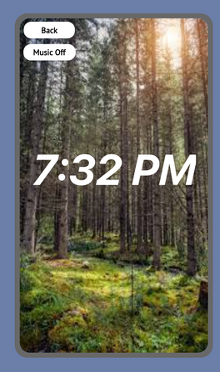

The Idea
Study Quest turns studying into a game. Students set goals, complete tasks, level up, earn rewards, and a focus mode. They do all of this while subconsciously reducing distraction.

Slide 5
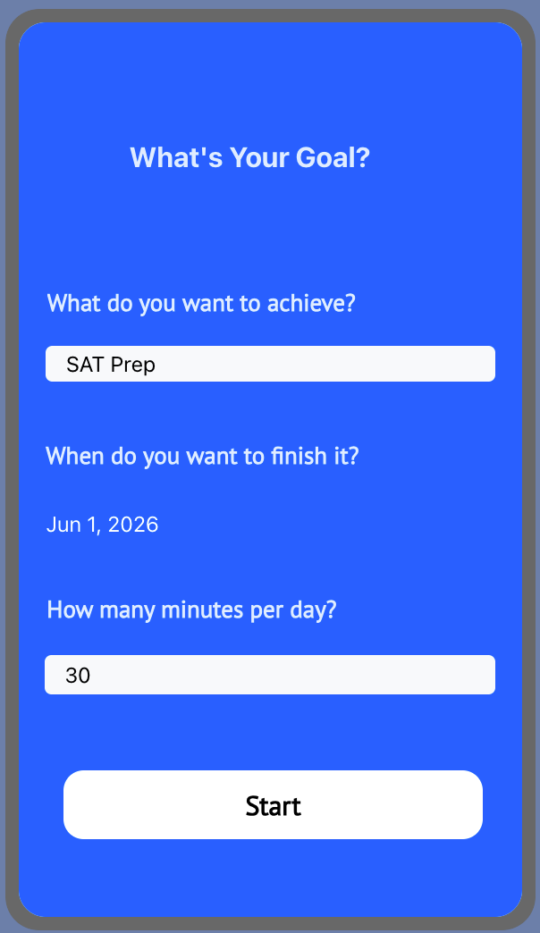
Whats you Goal Screen
  Once you pressed “Start Quest” on the home screen you get directed to “What’s your Goal?” screen
  Set a goal (ex: SAT prep)
  Choose deadline & daily time
  Choose how much minutes/time you want to spend per day

Slide 6
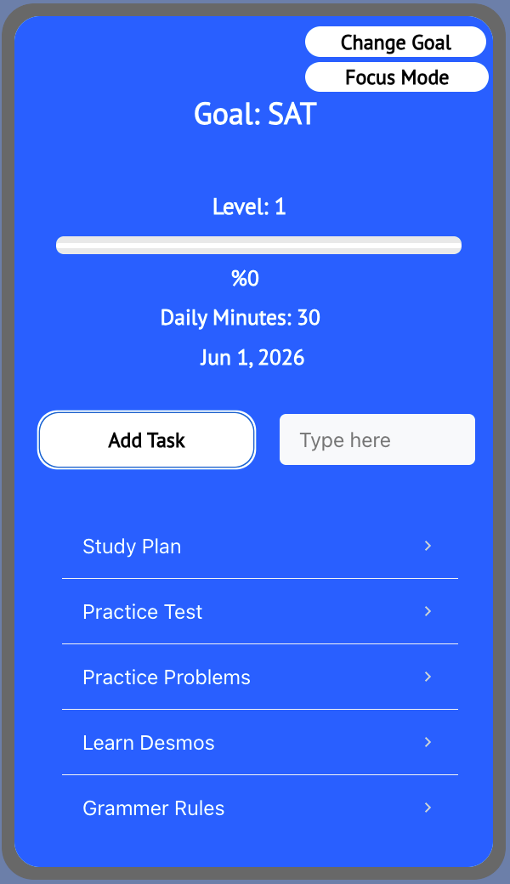
Dashboard Screen
  Displays the goal, the tasks inputed, progress bar, and user level.
  Completing tasks unlocks rewards to keep students motivated.

Slide 7
Rewards Screen
  Once they reach 100% on the progress bar and level up, the user is directed to the rewars page. This is where they spin the wheel and get a random reward!

Slide 8
Focus Mode Screen
  Beach, forest, or mountain environments
  Optional background music
  Designed to reduce digital distraction

Slide 9
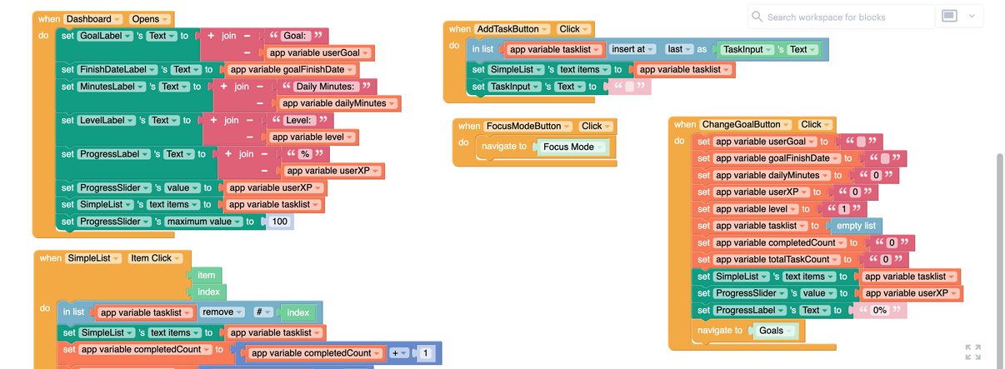


Tech Stack and Build
  Built using Thunkable
  Designed and programmed independently
  Has multi screen navigation, progress tracking, gamification logic, and interactive UI.
  GitHub: https://github.com/issaaalek/Study-Quest

